Slide 1
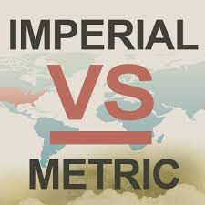
The Imperial vs. Metric System

Slide 2
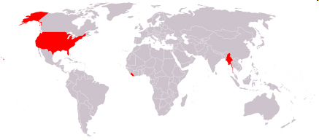
The countries colored in red are the ones that use the imperial system.
Canada (sometimes)
The United States
Burma
Liberia
Copyright © 2010 Ryan P. Murphy

Slide 3
The imperial system of units, imperial system or imperial units (also known as British Imperial or Exchequer Standards of 1826) is the system of units first defined in the British Weights and Measures Act 1824 and continued to be developed through a series of Weights and Measures Acts and amendments. The imperial units replaced the Winchester Standards, which were in effect from 1588 to 1825.
The system came into official use across the British Empire in 1826. By the late 20th century, most nations of the former empire had officially adopted the metric system as their main system of measurement, but imperial units are still used in the United Kingdom and some other countries formerly part of the British Empire.
Copyright © 2010 Ryan P. Murphy

Slide 4
Length Unit | Abbr. | Feet | Metres | Notes
thou | th | ¹⁄₁₂₀₀₀ | 0.000025 | Also known as mil^{[14]}
barleycorn | Bc | ¹⁄₃₆ | 0.008466 | ¹⁄₃ in
inch | in | ¹⁄₁₂ | 0.0254 | 1 metre ≈ 39.3701 in
foot | ft | 1 | 0.3048
yard | yd | 3 | 0.9144 | Defined as exactly 0.9144 m
chain | ch | 66 | 20.1168 | 100 links, 4 rods, or ¹⁄₁₀ of a furlong. The distance between the two wickets on a cricket pitch.
furlong | fur | 660 | 201.168 | 220 yd
mile | mi | 5280 | 1609.344 | 1760 yd or 80 chains
league | lea | 15840 | 4828.032
Copyright © 2010 Ryan P. Murphy

Slide 5
A thousandth of an inch is a derived unit of length in a system of units using inches. Equal to 1⁄1000 of an inch, a thousandth is commonly called a thou /ˈθaʊ/ (used for both singular and plural) or particularly in North America a mil (plural mils).
The thou, or mil, is most commonly used in engineering and manufacturing in non-metric countries. For example, in specifying:
The thickness of items such as paper, film, foil, wires, paint coatings, latex gloves, plastic sheeting, and fibers.
For example, most plastic ID cards are about 30 thou (0.76 mm) in thickness.
Card stock thickness in the United States, where mils are also called points.
Gauge (diameter) of strings in stringed instruments.
Copyright © 2010 Ryan P. Murphy

Slide 6
The barleycorn is a former English unit of length equal to 1⁄3 of an inch (i.e. about 8.47 mm). It is still used as the basis of shoe sizes in English-speaking countries.
Inch is equal to 1⁄36 yard or 1⁄12 of a foot. Derived from the Roman uncia ("twelfth"), the word inch is also sometimes used to translate similar units in other measurement systems, usually understood as deriving from the width of the human thumb.
Copyright © 2010 Ryan P. Murphy

Slide 7

  An inch represents the width of a thumb.

Slide 8
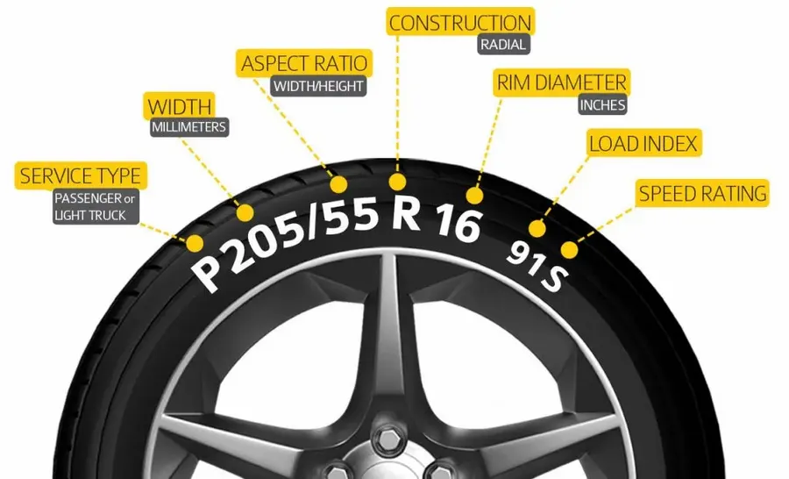
Inches are commonly used to specify the diameter of vehicle wheel rims, and the corresponding inner diameter of tyres – the last number in a Car/Truck tire size such as 235/75 R16; the first two numbers give the width (normally expressed in millimetres for cars and light trucks) and aspect ratio of the tyre (height 75% of width in this example), the R Designates a Radial Ply Construction.
Copyright © 2010 Ryan P. Murphy

Slide 9
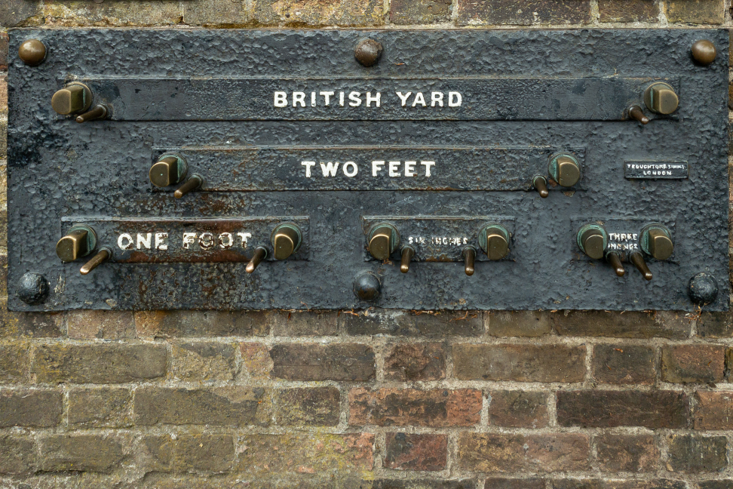
Since the International Yard and Pound Agreement of 1959, one foot is defined as 0.3048 meters exactly. In customary and imperial units, one foot comprises 12 inches and one yard comprises three feet.
Historically the "foot" was a part of many local systems of units, including the Greek, Roman, Chinese, French, and English systems. It varied in length from country to country, from city to city, and sometimes from trade to trade. Its length was usually between 250 mm and 335 mm and was generally, but not always, subdivided into 12 inches or 16 digits.
Copyright © 2010 Ryan P. Murphy

Slide 10
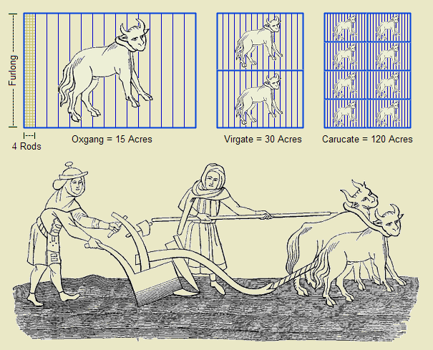
Since 1959 it is by international agreement standardized as exactly 0.9144 meters. 1,760 yards is equal to 1 mile. The name derives from the Old English gerd, gyrd etc. which was used for branches, staves, and measuring rods. It is first attested in the late-7th century laws of Ine of Wessex, where the "yard of land" mentione is the yardland, an old English unit of tax assessment equal to 1⁄4 hide.
Copyright © 2010 Ryan P. Murphy

Slide 11
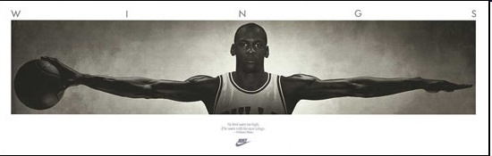
The yard is the distance from the tip of the nose to the end of the middle finger of the outstretched hand.

Slide 12
The chain is a unit of length equal to 66 feet (22 yards). It is subdivided into 100 links or 4 rods. There are 10 chains in a furlong, and 80 chains in one statute mile. In metric terms, it is 20.1168 m long.
A furlong is a measure of distance in imperial units and U.S. customary units equal to one eighth of a mile, equivalent to 660 feet, 220 yards, 40 rods, 10 chains or approximately 201 metres.
The mile, sometimes the international mile to distinguish it from other miles, is the British imperial unit and the US customary unit, both systems are based on the older English unit of length equal to 5,280 feet, or 1,760 yards, and standardised as exactly 1,609.344 metres by international agreement in 1959.
Copyright © 2010 Ryan P. Murphy

Slide 13
The chain is a unit of length equal to 66 feet (22 yards). It is subdivided into 100 links or 4 rods. There are 10 chains in a furlong, and 80 chains in one statute mile. In metric terms, it is 20.1168 m long.
A furlong is a measure of distance in imperial units and U.S. customary units equal to one eighth of a mile, equivalent to 660 feet, 220 yards, 40 rods, 10 chains or approximately 201 metres.
The mile, sometimes the international mile to distinguish it from other miles, is the British imperial unit and the US customary unit, both systems are based on the older English unit of length equal to 5,280 feet, or 1,760 yards, and standardised as exactly 1,609.344 metres by international agreement in 1959.
Copyright © 2010 Ryan P. Murphy

Slide 14
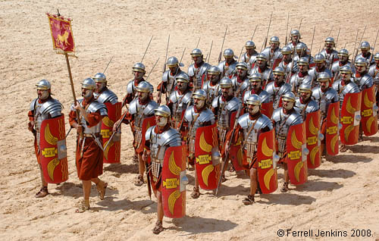
The mile is a Roman unit, originally defined to be the length of 2000 steps of a Roman legion.

Slide 15
Unit | Imperial ounces | Imperial pints | Millilitres | Cubic inches | US ounces | US pints
fluid ounce (fl oz) | 1 | ¹⁄₂₀ | 28.4130625 | 1.7339 | 0.96076 | 0.060047
gill (gi) | 5 | ¹⁄₄ | 142.0653125 | 8.6694 | 4.8038 | 0.30024
pint (pt) | 20 | 1 | 568.26125 | 34.677 | 19.215 | 1.2009
quart (qt) | 40 | 2 | 1136.5225 | 69.355 | 38.430 | 2.4019
gallon (gal) | 160 | 8 | 4546.09 | 277.42 | 153.72 | 9.607
Copyright © 2010 Ryan P. Murphy

Slide 16
A fluid ounce (abbreviated fl oz, fl. oz. or oz. fl., old forms ℥, fl ℥, f℥, ƒ ℥) is a unit of volume (also called capacity) typically used for measuring liquids. Various definitions have been used throughout history, but only two are still in common use: the British Imperial and the United States customary fluid ounce.
An imperial fluid ounce is 1⁄20 of an imperial pint, 1⁄160 of an imperial gallon or approximately 28.41 ml.
A US fluid ounce is 1⁄16 of a US fluid pint and 1⁄128 of a US liquid gallon or approximately 29.57 ml, making it about 4.08% larger than the imperial fluid ounce.
Copyright © 2010 Ryan P. Murphy

Slide 17
The gallon is a unit of measurement for volume and fluid capacity in both the US customary units and the British imperial systems of measurement. Three significantly different sizes are in current use:
the imperial gallon (imp gal), defined as 4.54609 litres, which is or was once used in the United Kingdom, Canada, and some Caribbean nations;
the US gallon (US gal) defined as 231 cubic inches (exactly 3.785411784 litres), which is used in the US and some Latin American and Caribbean countries; and
the US dry gallon ("usdrygal"), defined as 1⁄8 US bushel (exactly 4.40488377086 litres).
Copyright © 2010 Ryan P. Murphy

Slide 18
In the 19th and 20th centuries, the UK used three different systems for mass and weight.
troy weight, used for precious metals;
avoirdupois weight, used for most other purposes; and
apothecaries' weight, now virtually unused since the metric system is used for all scientific purposes.
The word avoirdupois is from Anglo-Norman French aveir de peis (later avoir du pois), literally "goods of weight" (Old French aveir, as verb meaning "to have" and as noun meaning "property, goods", comes from the Latin habere, "to have, to hold, to possess something"; de = "from"/"of", cf. Latin; peis = "weight", from Latin pensum). This term originally referred to a class of merchandise: aveir de peis, "goods of weight", things that were sold in bulk and were weighed on large steelyards or balances.
Copyright © 2010 Ryan P. Murphy

Slide 19
Unit | Pounds | Grams | Kilograms
grain (gr) | ¹⁄₇₀₀₀ | 0.06479891
drachm (dr) | ¹⁄₂₅₆ | 1.7718451953125
ounce (oz) | ¹⁄₁₆ | 28.349523125
pound (lb) | 1 | 453.59237 | 0.45359237
stone (st) | 14 | 6350.29318 | 6.35029318
quarter (qr or qtr) | 28 |  | 12.70058636
hundredweight (cwt) | 112 |  | 50.80234544
ton (t) | 2240 |  | 1016.0469088

Slide 20
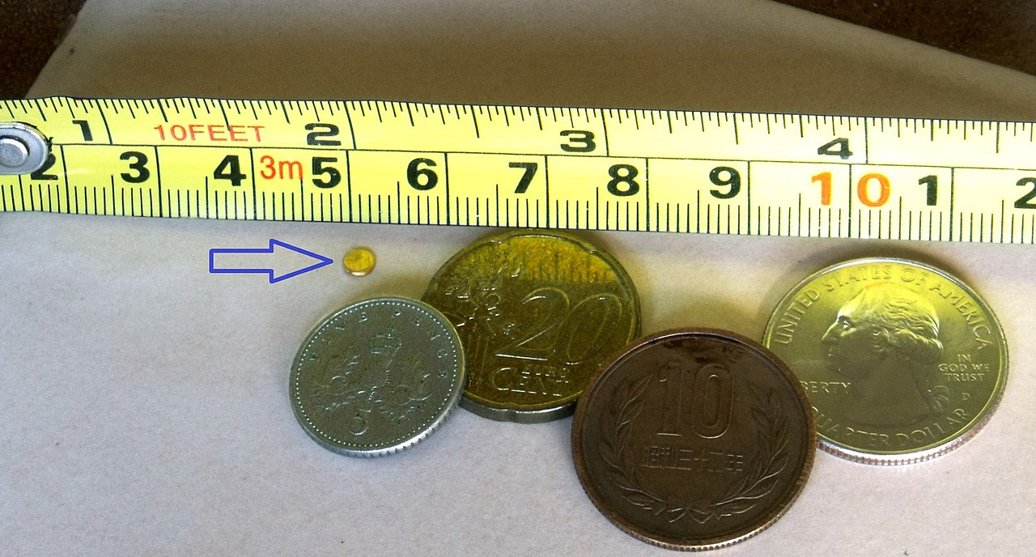
A grain is a unit of measurement of mass, and in the troy weight, avoirdupois, and Apothecaries' system, equal to exactly 64.79891 milligrams. It is nominally based upon the mass of a single ideal seed of a cereal. From the Bronze Age into the Renaissance the average masses of wheat and barley grains were part of the legal definitions of units of mass.
Copyright © 2010 Ryan P. Murphy

Slide 21
The Attic Greek drachma was a weight of 6 obols, 1⁄100 Greek mina, or about 4.37 grams.
The Roman drachma was a weight of 1⁄96 Roman pounds, or about 3.41 grams.
A coin weighing one drachma is known as a stater, drachm, or drachma. The Ottoman dirhem was based on the Sassanian drachm, which was itself based on the Roman dram/drachm.
In the avoirdupois system, the dram is the mass of 1⁄256 pound or 1⁄16 ounce. The dram weighs exactly 1.7718451953125 grams.
Dram is used informally to mean a small amount of spirituous liquor, especially Scotch whisky. The unit is referenced by the phrase dram shop, the US legal term for an establishment that serves alcoholic beverages
Copyright © 2010 Ryan P. Murphy

Slide 22

Besides the common ounce, several other ounces are in current use:
The troy ounce of 31.1034768 grams is used for the mass of precious metals such as gold, silver, platinum, palladium, rhodium, etc.
Copyright © 2010 Ryan P. Murphy

Slide 23
The pound or pound-mass is a unit of mass used in the imperial, United States customary and other systems of measurement. Various definitions have been used; the most common today is the international avoirdupois pound, which is legally defined as exactly 0.45359237 kilograms, and which is divided into 16 avoirdupois ounces.
The libra (Latin for "scales / balance") is an ancient Roman unit of mass that was equivalent to approximately 328.9 grams. It was divided into 12 unciae (singular: uncia), or ounces. The libra is the origin of the abbreviation for pound, "lb".
Copyright © 2010 Ryan P. Murphy

Slide 24
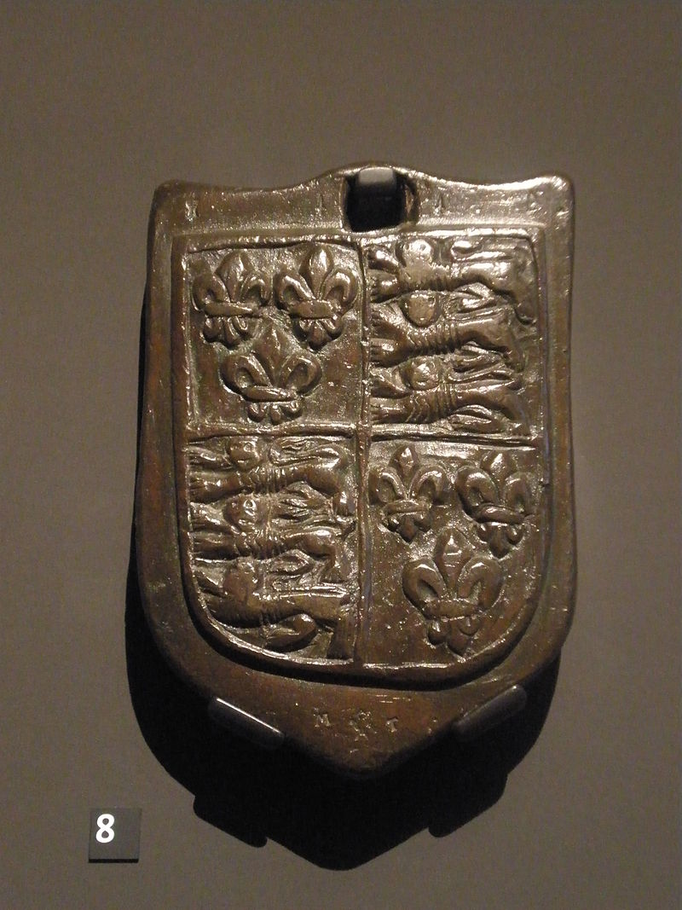
The stone or stone weight (abbreviation: st.) is an English and imperial unit of mass equal to 14 pounds (approximately 6.35 kg). The stone continues in customary use in the United Kingdom and Ireland for body weight.
Copyright © 2010 Ryan P. Murphy

Slide 25
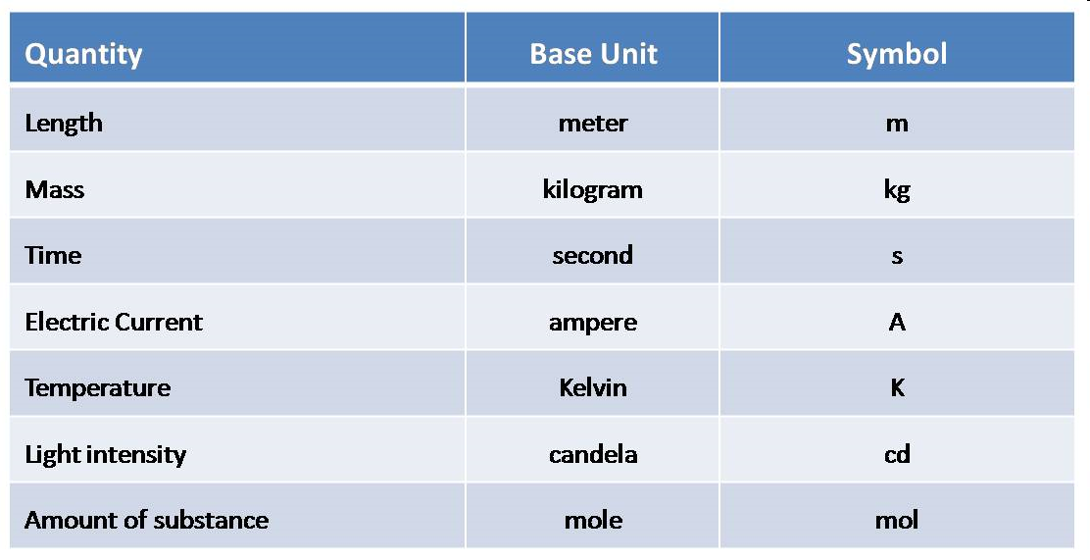
The International System (System Internationale ‘unites) of Units (SI) also known as THE METRIC SYSTEM.
Copyright © 2010 Ryan P. Murphy

Slide 26
The simplicity of the metric system
=
only one unit of measurement for each type of quantity measured
SI
For example:
One for length (meter)
One for mass (gram)
One for volume (liter)
Copyright © 2010 Ryan P. Murphy

Slide 27
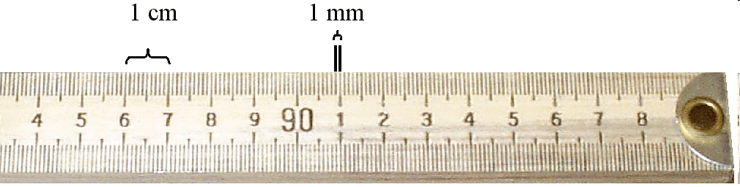
The measurements below are all the same.
    “I am 1828.80 mm tall.”
    “I am 182.80 cm tall.”
    “I am 1.8280 meters tall.”
    “I am .001828 km tall.”
Copyright © 2010 Ryan P. Murphy

Slide 28
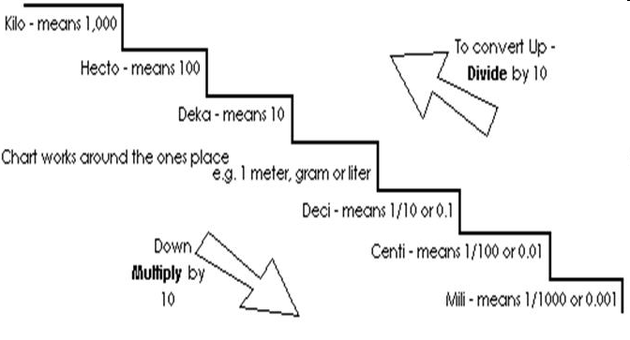
You can measure the very small and the very large with the same unit. (Meter)
  1,000,000 kilometers and 1 millimeter.
Copyright © 2010 Ryan P. Murphy

Slide 29
SI
For example:
One for length (meter)
One for mass (gram)
One for volume (liter)
Compare it with Imperial System
Imperial
For example:
Length: mile, yard, foot/feet, inch…
Mass: grain (≈0.65g), drachm (1.77 g), pound (453 g) etc…
Volume: ounce (0.028 L), gill (0.142 L), gallon (4.55 L)…
Copyright © 2010 Ryan P. Murphy

Slide 30
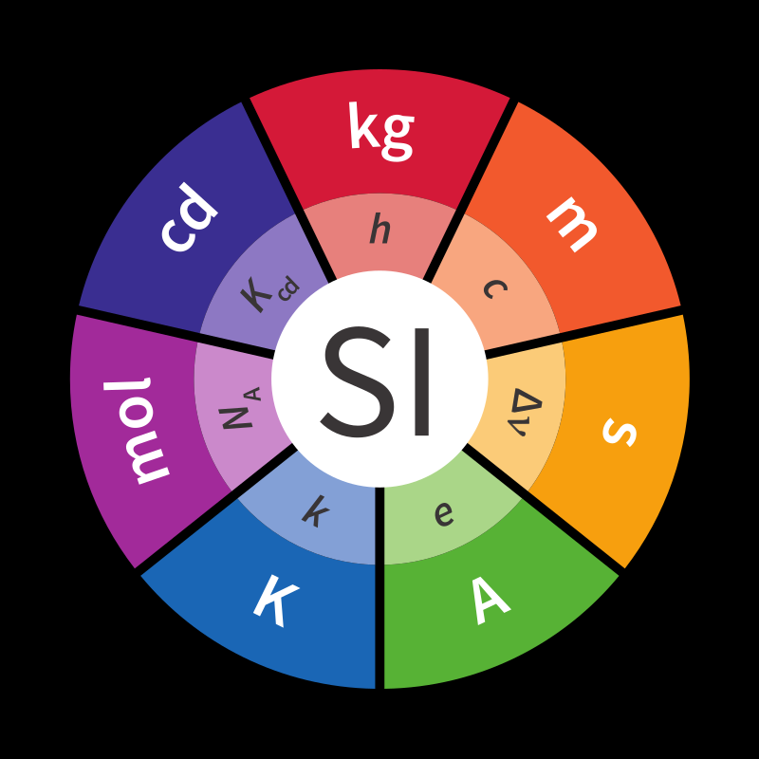
SI UNITS
Copyright © 2010 Ryan P. Murphy

Slide 31
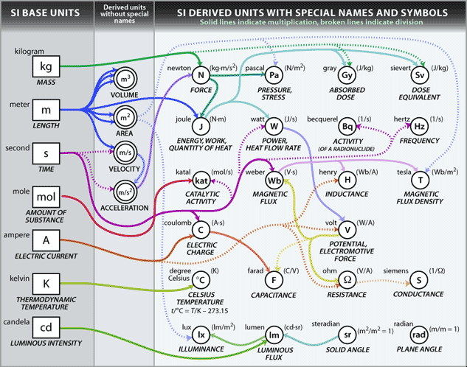
Copyright © 2010 Ryan P. Murphy

Slide 32
hertz | Hz | frequency | 1/s | s⁻¹
radian | rad | angle | m/m | 1
steradian | sr | solid angle | m²/m² | 1
newton | N | force, weight | kg⋅m/s² | kg⋅m⋅s⁻²
pascal | Pa | pressure, stress | N/m² | kg⋅m⁻¹⋅s⁻²
joule | J | energy, work, heat | m⋅N, C⋅V, W⋅s | kg⋅m²⋅s⁻²
watt | W | power, radiant flux | J/s, V⋅A | kg⋅m²⋅s⁻³
coulomb | C | electric charge or quantity of electricity | s⋅A, F⋅V | s⋅A
volt | V | voltage, electrical potential difference, electromotive force | W/A, J/C | kg⋅m²⋅s⁻³⋅A⁻¹
farad | F | electrical capacitance | C/V, s/Ω | kg⁻¹⋅m⁻²⋅s⁴⋅A²
ohm | Ω | electrical resistance, impedance, reactance | 1/S, V/A | kg⋅m²⋅s⁻³⋅A⁻²
Copyright © 2010 Ryan P. Murphy

Slide 33
siemens | S | electrical conductance | 1/Ω, A/V | kg⁻¹⋅m⁻²⋅s³⋅A²
weber | Wb | magnetic flux | J/A, T⋅m²,V⋅s | kg⋅m²⋅s⁻²⋅A⁻¹
tesla | T | magnetic induction, magnetic flux density | V⋅s/m², Wb/m², N/(A⋅m) | kg⋅s⁻²⋅A⁻¹
henry | H | electrical inductance | V⋅s/A, Ω⋅s, Wb/A | kg⋅m²⋅s⁻²⋅A⁻²
degree Celsius | °C | temperature relative to 273.15 K | K | K
lumen | lm | luminous flux | cd⋅sr | cd
lux | lx | illuminance | lm/m² | cd⋅m⁻²
becquerel | Bq | radioactivity (decays per unit time) | 1/s | s⁻¹
gray | Gy | absorbed dose (of ionizing radiation) | J/kg | m²⋅s⁻²
sievert | Sv | equivalent dose (of ionizing radiation) | J/kg | m²⋅s⁻²
katal | kat | catalytic activity | mol/s | s⁻¹⋅mo
Copyright © 2010 Ryan P. Murphy

Slide 34
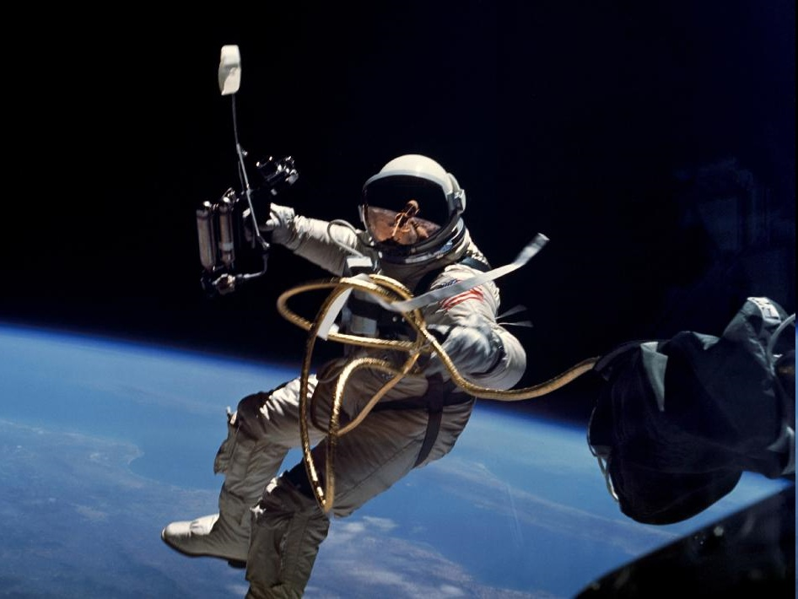
Mass: The amount of matter in an object.
Copyright © 2010 Ryan P. Murphy

Slide 35
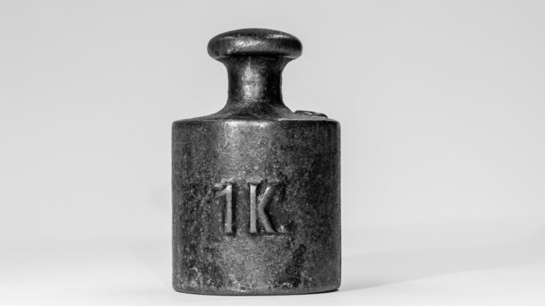
THE BASE UNIT = kilogram
SYMBOL = kg

Slide 36
The kilogram was originally defined in 1795 as the mass of one litre of water. This definition was simple yet difficult to use in practice.
The kilogram is defined in terms of three fundamental physical constants: The speed of light c, a specific atomic transition frequency ΔνCs, and the Planck constant h. The formal definition is:
The kilogram, symbol kg, is the SI unit of mass. It is defined by taking the fixed numerical value of the Planck constant h to be 6.62607015×10−34 when expressed in the unit J⋅s, which is equal to kg⋅m2⋅s−1, where the metre and the second are defined in terms of c and ΔνCs.
This definition makes the kilogram consistent with the older definitions: the mass remains within 30 ppm of the mass of one litre of water.
Copyright © 2010 Ryan P. Murphy

Slide 37
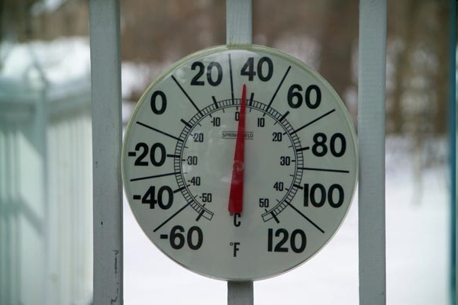
The degree of hotness or coldness of an object
Copyright © 2010 Ryan P. Murphy

Slide 38
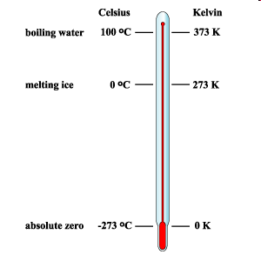
THE BASE UNIT = kelvin
SYMBOL = K
Copyright © 2010 Ryan P. Murphy

Slide 39
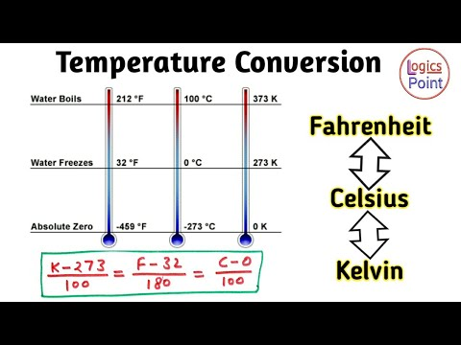
The kelvin is the base unit of temperature in the International System of Units (SI), having the unit symbol K. It is named after the Belfast-born Glasgow University engineer and physicist William Thomson, 1st Baron Kelvin (1824–1907).
Copyright © 2010 Ryan P. Murphy

Slide 40

The Metric (SI) System
TIME
Copyright © 2010 Ryan P. Murphy

Slide 41
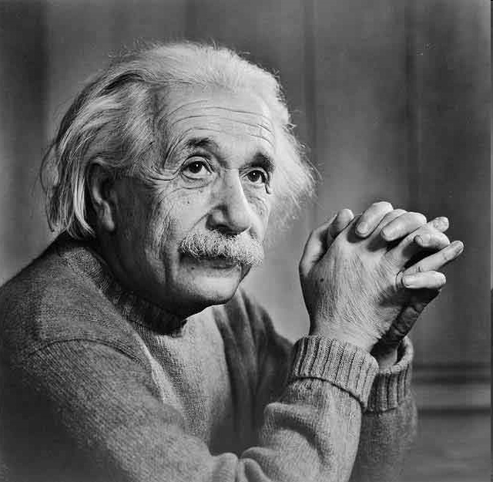
Remember: Time is not the same everywhere. Time speeds up and slows down. The faster you are going, the slower time travels.

Slide 42
THE BASE UNIT = second
SYMBOL = s
Even the best mechanical, electric motorized and quartz crystal-based clocks develop discrepancies from environmental conditions. Far better for timekeeping is the natural and exact "vibration" in an energized atom. The frequency of vibration (i.e., radiation) is very specific depending on the type of atom and how it is excited. Since 1967, the second has been defined as exactly "the duration of 9,192,631,770 periods of the radiation corresponding to the transition between the two hyperfine levels of the ground state of the caesium-133 atom" (at a temperature of 0 K).

Slide 43
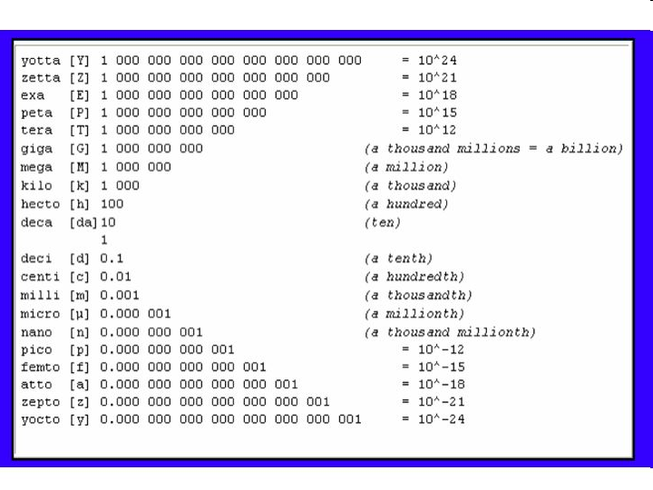
POWERS OF TEN HAVE PREFIXES
Copyright © 2010 Ryan P. Murphy

Slide 44
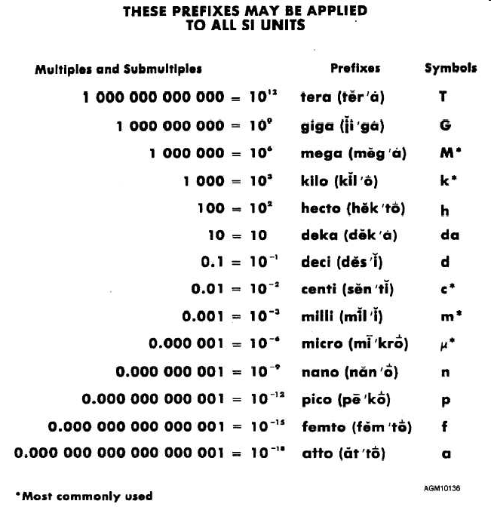
On the very last page in your textbook!!
YOU MUST KNOW THEM!!!
Copyright © 2010 Ryan P. Murphy

