Slide 1
British English vs. American English

Slide 2
Topics
Introduction
Pronounciation
Grammar
Vocabulary
Spelling

Slide 3

Introduction
The English language was first introduced to the Americas by British colonisation, beginning in the late 16th and early 17th centuries. The language also spread to numerous other parts of the world as a result of British trade and colonisation and the spread of the former British Empire, which, by 1921, included about 470–570 million people, about a quarter of the world's population.
Written forms of British and American English as found in newspapers and textbooks vary little in their essential features, with only occasional noticeable differences.

Slide 4
Introduction
Over the past 400 years, the forms of the language used in the Americas—especially in the United States—and that used in the United Kingdom have diverged in a few minor ways, leading to the versions now often referred to as American English and British English.
Differences between the two include pronunciation, grammar, vocabulary (lexis), spelling, punctuation, idioms, and formatting of dates and numbers. However, the differences in written and most spoken grammar structure tend to be much less than in other aspects of the language in terms of mutual intelligibility.

Slide 5
Introduction
This divergence between American English and British English has provided opportunities for humorous comment: e.g. in fiction George Bernard Shaw says that the United States and United Kingdom are "two countries divided by a common language";
and Oscar Wilde says that "We have really everything in common with America nowadays, except, of course, the language" (The Canterville Ghost, 1888).
Henry Sweet incorrectly predicted in 1877 that within a century American English, Australian English and British English would be mutually unintelligible (A Handbook of Phonetics)

Slide 6
Pronounciation Differences
American vs. British vs. Australian English | One Language, Three Accents
British vs American Accents
The English Language In 24 Accents

Slide 7
Grammar Differences
https://www.onestopenglish.com/
Infinitive | Simple past (Br) | Simple past (Am) | Past participle (Br) | Past participle (Am)
burn | burned/ burnt | burned/ burnt | burned/ burnt | burned/ burnt
bust | bust | busted | bust | busted
dive | dived | dove/ dived | dived | dived
dream | dreamed/ dreamt | dreamed/ dreamt | dreamed/ dreamt | dreamed/ dreamt
get | got | got | got | gotten
lean | leaned/ leant | leaned | leaned/ leant | leaned
learn | learned/ learnt | learned | learned/ learnt | learned
plead | pleaded | pleaded/ pled | pleaded | pleaded/ pled

Slide 8
Grammar Differences
Infinitive | Simple past (Br) | Simple past (Am) | Past participle (Br) | Past participle (Am)
prove | proved | proved | proved | proved/ proven
saw | sawed | sawed | sawn | sawn/ sawed
smell | smelled/ smelt | smelled | smelled/ smelt | smelled
spill | spilled/ spilt | spilled | spilled/ spilt | spilled
spoil | spoiled/ spoilt | spoiled/ spoilt | spoiled/ spoilt | spoiled/ spoilt
stink | stank | stank/ stunk | stunk | stunk
wake | woke | woke/ waked | woken | woken
prove | proved | proved | proved | proved/ proven

Slide 9
Grammar Differences
1. In sentences which talk about an action in the past that has an effect in the present:
American English (AmE) / British English (BrE)
Jenny feels ill. She ate too much. (AmE)
Jenny feels ill. She's eaten too much. (BrE)
I can't find my keys. Did you see them anywhere? (AmE)
I can't find my keys. Have you seen them anywhere? (BrE)
https://www.onestopenglish.com/

Slide 10
Grammar Differences
2. In sentences which contain the words already, just or yet:
A: Are they going to the show tonight?
B: No. They already saw it. (AmE)
A: Are they going to the show tonight?
B: No. They've already seen it. (BrE)
A: Is Samantha here?
B: No, she just left. (AmE)
A: Is Samantha here?
B: No, she's just left. (BrE)
https://www.onestopenglish.com/

Slide 11
Grammar Differences
3. Verb agreement with collective nouns
In British English, collective nouns, (i.e. nouns referring to particular groups of people or things), (e.g. staff, government, class, team) can be followed by a singular or plural verb depending on whether the group is thought of as one idea, or as many individuals, e.g.
My team is winning.
The other team are all sitting down.
In American English, collective nouns are always followed by a singular verb, so an American would usually say:
Which team is losing?
https://www.onestopenglish.com/

Slide 12
Grammar Differences
4. Use of delexical verbs have and take
I'd like to have a bath.
Have is frequently used in this way with nouns referring to common activities such as washing or resting, e.g.
She's having a little nap.
I'll just have a quick shower before we go out.
In American English, the verb take, rather than have, is used in these contexts, e.g.
Joe's taking a shower.
I'd like to take a bath.
Let's take a short vacation.
Why don't you take a rest now?
https://www.onestopenglish.com/

Slide 13
Grammar Differences
5. Use of auxiliaries and modals
In British English, the auxiliary do is often used as a substitute for a verb when replying to a question, e.g.
A: Are you coming with us?
B: I might do.
In American English, do is not used in this way, e.g.
A: Are you coming with us?
B: I might.
https://www.onestopenglish.com/

Slide 14
Grammar Differences
In British English, needn't is often used instead of don't need to, e.g.
They needn't come to school today.
They don't need to come to school today.
In American English, needn't is very unusual and the usual form is don't need to, e.g.
They don't need to come to school today.
In British English, shall is sometimes used as an alternative to will to talk about the future, e.g.
https://www.onestopenglish.com/

Slide 15
Grammar Differences
I shall/will be there later.
In American English, shall is unusual and will is normally used.
In British English, shall I/we is often used to ask for advice or an opinion, e.g.
Shall we ask him to come with us?
In American English, should is often used instead of shall, e.g.
Should we ask him to come with us?
https://www.onestopenglish.com/

Slide 16
Grammar Differences
6. Use of prepositions
In British English, at is used with many time expressions, e.g.
at Christmas/five 'o' clock
at the weekend
In American English, on is always used when talking about the weekend, not at, e.g.
Will they still be there on the weekend?
She'll be coming home on weekends.
https://www.onestopenglish.com/

Slide 17
Grammar Differences
In British English, at is often used when talking about universities or other institutions, e.g.
She studied chemistry at university.
In American English, in is often used, e.g.
She studied French in high school.
In British English, to and from are used with the adjective different, e.g.
This place is different from/to anything I've seen before.
In American English from and than are used with different, e.g.
This place is different from/than anything I've seen before.
In British English, to is always used after the verb write, e.g.
https://www.onestopenglish.com/

Slide 18
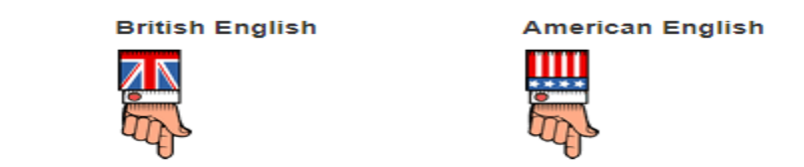
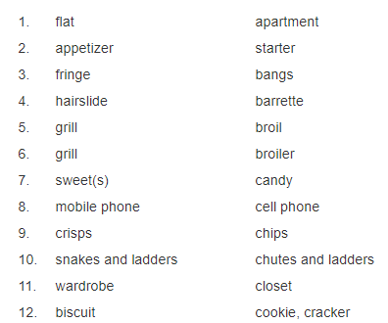
Vocabulary Differences
https://www.spellzone.com/

Slide 19
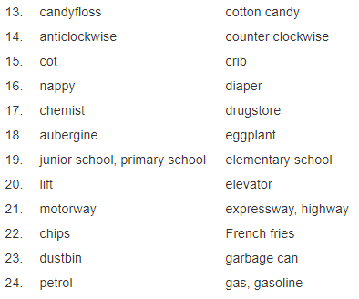
Vocabulary Differences
https://www.spellzone.com/

Slide 20
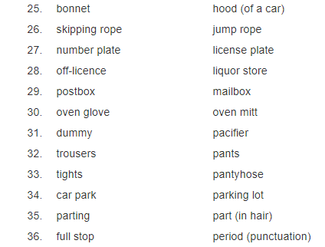
Vocabulary Differences
https://www.spellzone.com/

Slide 21
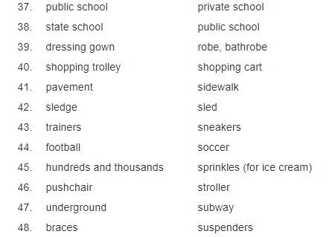
Vocabulary Differences
https://www.spellzone.com/

Slide 22
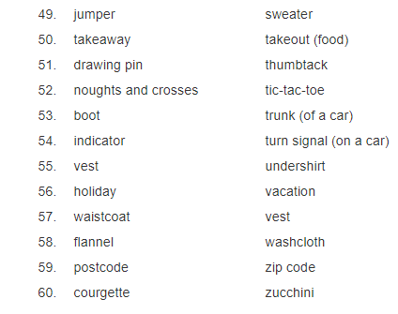
Vocabulary Differences
https://www.spellzone.com/

Slide 23
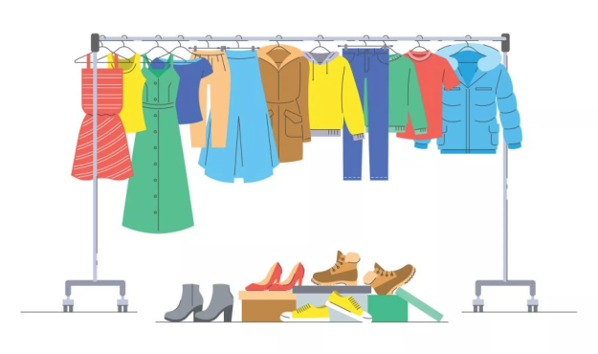
Vocabulary Differences
British vs. American English: Clothes
Bonnet —–<>—– Hat
Bootlace, Shoelace —–<>—– Shoestring
Clothes peg —–<>—– Clothespin
Dressing Gown —–<>—– Bath Rope
Dungaress —–<>—– Overalls
Nappy —–<>—– Diaper
Underwear, Knickers —–<>—– Underwear, Panties
Plimsolls, Gym Shoes —–<>—– Gym Shoes
Polo Neck —–<>—– Turtle Neck
Pyjamas —–<>—– Pajamas
https://7esl.com/british-and-american-english/

Slide 24

Vocabulary Differences
British and American English: Food & Kitchen
Aubergine —–<>—– Eggplant
Beetroot —–<>—– Beet
Biscuit —–<>—– Cookie
Black Treacle —–<>—– Molasses
Broad Bean —–<>—– Lima Bean
Chips —–<>—– French Fries
Cling Film —–<>—– Plastic Wrap
Cooker —–<>—– Range, Stove
Courgette —–<>—– Zucchini
Coriander—–<>—– Cilantro
Crisps —–<>—– (Potato) Chips
https://7esl.com/british-and-american-english/

Slide 25

Vocabulary Differences
British vs. American English: Transportation
A single ticket —–<>—– One way ticket
Aeroplane —–<>—– Airplane
Bonnet —–<>—– Hood
Boot —–<>—– Trunk
Crossroads —–<>—– Intersection, crossroads
Diversion —–<>—– Detour
Driving Licence —–<>—– Driver’s License
Dual Carriageway —–<>—– Divided Highway
Estate car —–<>—– Station Wagon
https://7esl.com/british-and-american-english/

Slide 26
Vocabulary Differences
British and American English: Miscellaneous
Anti Clockwise —–<>—– Counter-Clockwise
Autumn —–<>—– Fall
Car Boot Sale —–<>—– Garage Sale
Caretaker —–<>—– Janitor
Cashier —–<>—– Teller
Chap —–<>—– Guy
Dear —–<>—– Expensive
Draughts —–<>—– Checkers
Draw —–<>—– Tie
Mum, Mummy—–<>—– Mom, Mommy, Ma
Nil (Sport) —–<>—– Nothing, Zero
Noughts and Crosses —–<>—– Tic Tac Toe
https://7esl.com/british-and-american-english/

Slide 27
Vocabulary Differences
British and American English: Miscellaneous
Mate —–<>—– Buddy
A Full Stop —–<>—– A Period
An Exclamation Mark —–<>—– An Exclamation Point
Round Brackets —–<>—– Parentheses
Square Brackets —–<>—– Brackets
Curly Brackets —–<>—– Curly Braces
Cling Film —–<>—– Plastic Wrap
Dummy for Baby —–<>—– Pacifier
Sweets —–<>—– Candy
Rubbish —–<>—– Garbage (Trash)
Drawing-pin —–<>—– Thumb tack
Dustbin —–<>—– Trash can
Chemist’s —–<>—– Drugstore/ Pharmacy
https://7esl.com/british-and-american-english/

Slide 28
Vocabulary Differences
Can you match each American English word or phrase with its British counterpart?

Slide 29
Spelling Differences
British English | American English
-oe-/-ae- (e.g. anaemia, diarrhoea, encyclopaedia) | -e- (e.g. anemia, diarrhea, encyclopedia)
-t (e.g. burnt, dreamt, leapt) | -ed (e.g. burned, dreamed, leaped)
-ence (e.g. defence, offence, licence) | -ense (defense, offense, license)
-ell- (e.g. cancelled, jeweller, marvellous) | -el- (e.g. canceled, jeweler, marvelous)
-ise (e.g. appetiser, familiarise, organise) | -ize (e.g. appetizer, familiarize, organize)
-l- (e.g. enrol, fulfil, skilful) | -ll- (e.g. enroll, fulfill, skillfull)
-ogue (e.g. analogue, monologue, catalogue) | -og (e.g. analog, monolog, catalog) *Note that American English also recognizes words spelled with –ogue
-ou (e.g. colour, behaviour, mould) | -o (e.g. color, behavior, mold)
-re (e.g. metre, fibre, centre) | -er (e.g. meter, fiber, center)
-y- (e.g. tyre) | -i- (e.g. tire)

Slide 30
Time and Dates
The British generally say “… past…” (“Ten past four in the morning” for 04:10, etc) and “… to…” (“Ten to four in the morning” for 3:50, etc) with times. In the US there is more variation, but equivalents that are not common in the UK include “… after…” and “…of/ before…” British people also fairly often leave out the “half” from “half past” in expressions like “half six”.
British dates are written and said in the order day, then month, and then year. Between those three British people usually add “the”, an ordinal number ending and “of”, as in “The twenty second of December nineteen seventy eight” for “22/12/1978”. The less common way of saying it just with numbers and no month word (“The twenty second of the twelfth nineteen seventy eight”) also seems to be mainly a British thing.
https://www.usingenglish.com/

Slide 31
Time and Dates
American dates are written and said month, then day, then year, usually without extra words and with simple cardinal numbers (“12/22/1978” and “December twenty two nineteen seventy eight”).
All this means that you don’t know if a written date like “2/3/2010” is “The second of March two thousand and ten” or “February three two thousand ten” until you know if it was written in the British or American way!
https://www.usingenglish.com/

Slide 32
Time and Dates
A smaller but occasionally just as confusing difference is that the British tend to think of the week as starting on Monday and finishing on Sunday, whereas Americans usually start counting from Sunday.
There are also minor differences in prepositions of time, including “at the weekend”/ “on the weekend”, “Monday to Friday”/ “Monday through/ thru Friday” and “See you on Monday”/ “See you (on) Monday”. Americans also rarely say “fortnight” for two weeks.
https://www.usingenglish.com/

Slide 33
Time and Dates
There are other differences which are as more like vocabulary but are also connected to time, including the British saying “bank holiday” for what Americans call “(national/ federal) holiday”, with “holiday” in British English meaning what Americans call a “vacation”.
Although I rarely hear it used nowadays, there is also a difference in the meaning of “momentarily”. If a British person says “I have to leave momentarily” they mean “I have to leave now but I’ll be back soon”/ “I have to leave for a (little) while”, whereas an American saying the same thing means “I have to leave soon “(and probably not come back at all).
https://www.usingenglish.com/

Slide 34
Time and Dates
The British tend to add “and” in large numbers between hundreds and tens, including in years (“two thousand and ten”/ “two thousand ten”). Americans are more likely to use “hundred” for numbers over a thousand, including quite big numbers (“four thousand five hundred”/ “forty five hundred” or “four thousand five hundred”).
Although it is now extinct, the traditional British billion used to mean a million million (“1,000,000,000,000”, now called a trillion).
https://www.usingenglish.com/

Slide 35
Time and Dates
Americans use “zero” for almost any use of “0”, but there are many British variations, including:
British usually use “oh” in telephone numbers where Americans might say “zero” (“oh seven nine two”/ “zero seven nine two”)
The British use “nil” for scores in some sports such as soccer (e.g. “three nil”/ “three zero”)
The British also use “nought”, especially in decimals (“nought point oh five”/ “zero point zero five”), but also in expressions like “from nought to sixty (miles per hour) in six seconds” and “for ages nought to seven”
https://www.usingenglish.com/

Slide 36
Time and Dates
In addition to the use of “nil” in British English sports scores, there is also a difference in the order in which the scores are given.
In American sports such as baseball and American football, the home team’s score is given last, whereas in all sports in the UK it is the other way around. This means that if a British person writes or says “7-1” they always mean that the home team won, but if for an American “7-1” may mean that the visiting team won (depending on what sport they are talking about).
https://www.usingenglish.com/

